Slide 1



Digital systems
Led by: Professor. Arnesh Telukdarie
Johannesburg Business School
November 2022

Slide 2


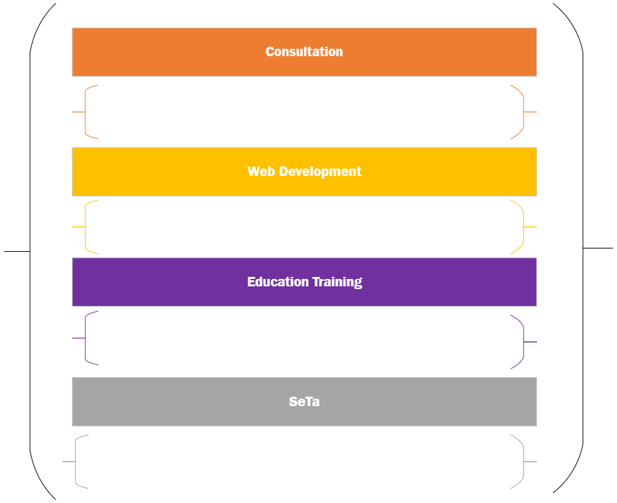
Projects

Slide 3

Consultation

Slide 4
Joburg Water

Slide 5

Joburg water project
1
2
3
Water and Energy
Water and Health
Water and Chemistry
Water And Nanotechnology
Purification
Energy
People
Time
Finances
Equipment
Chemicals
Distribution
Energy
People
Time
Finances
Equipment
Wastewater Management
Energy
People
Time
Finances
Equipment
Chemicals
Water and Digital/ Business
Water and Biological Science
Water and Chemical Engineering
PEETS: Process Energy and Environmental Technology Station

Slide 6
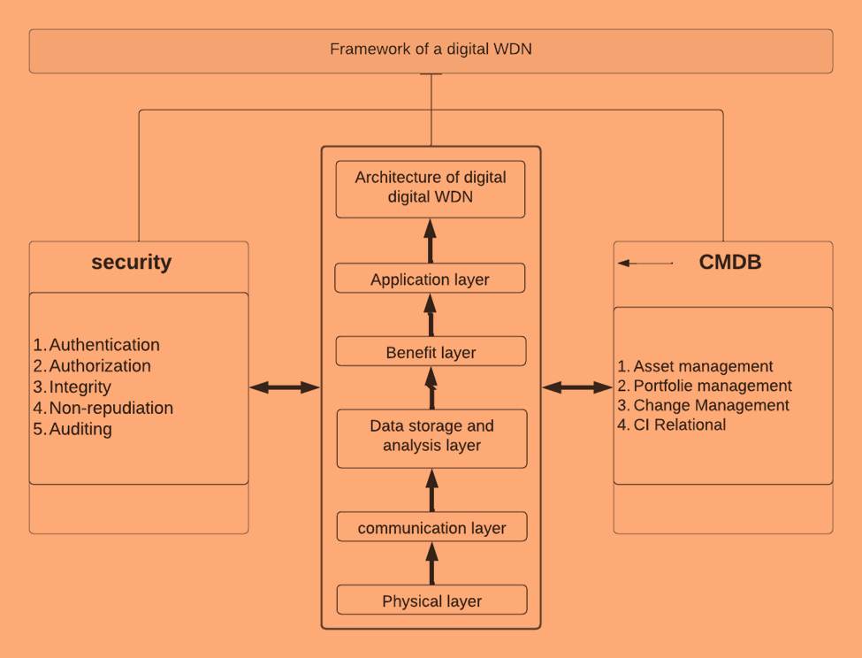
The 4IR framework for Water distribution Network
The Framework assists water utilities in understanding the classification of 4IR in smart water distribution, such as:
Big data
Smart sensors
Advanced data analytics
Machine learning
AI
Robotics
Digital Twin
Cyber-physical systems
Internet of Things

Slide 7
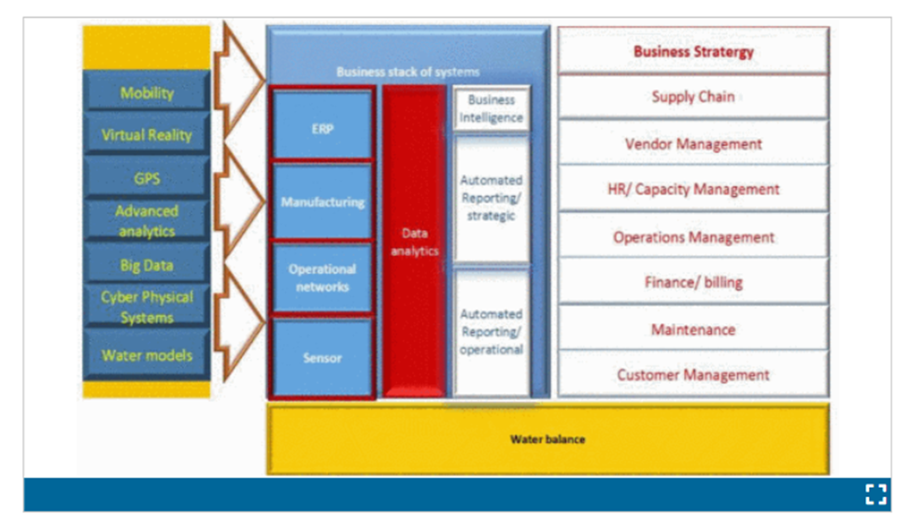
Water 4.0 Revolution Integrated Business Model
Effective water digitalisation drives alignment and integration which improves combined water infrastructure or related processes; enables integration and management of horizontal and vertical value chains in enterprise operations; and requires interface amongst applied systems premised on highly specialized user interface and software combined into digital networks, to formulate entirely new system functionality platforms

Slide 8
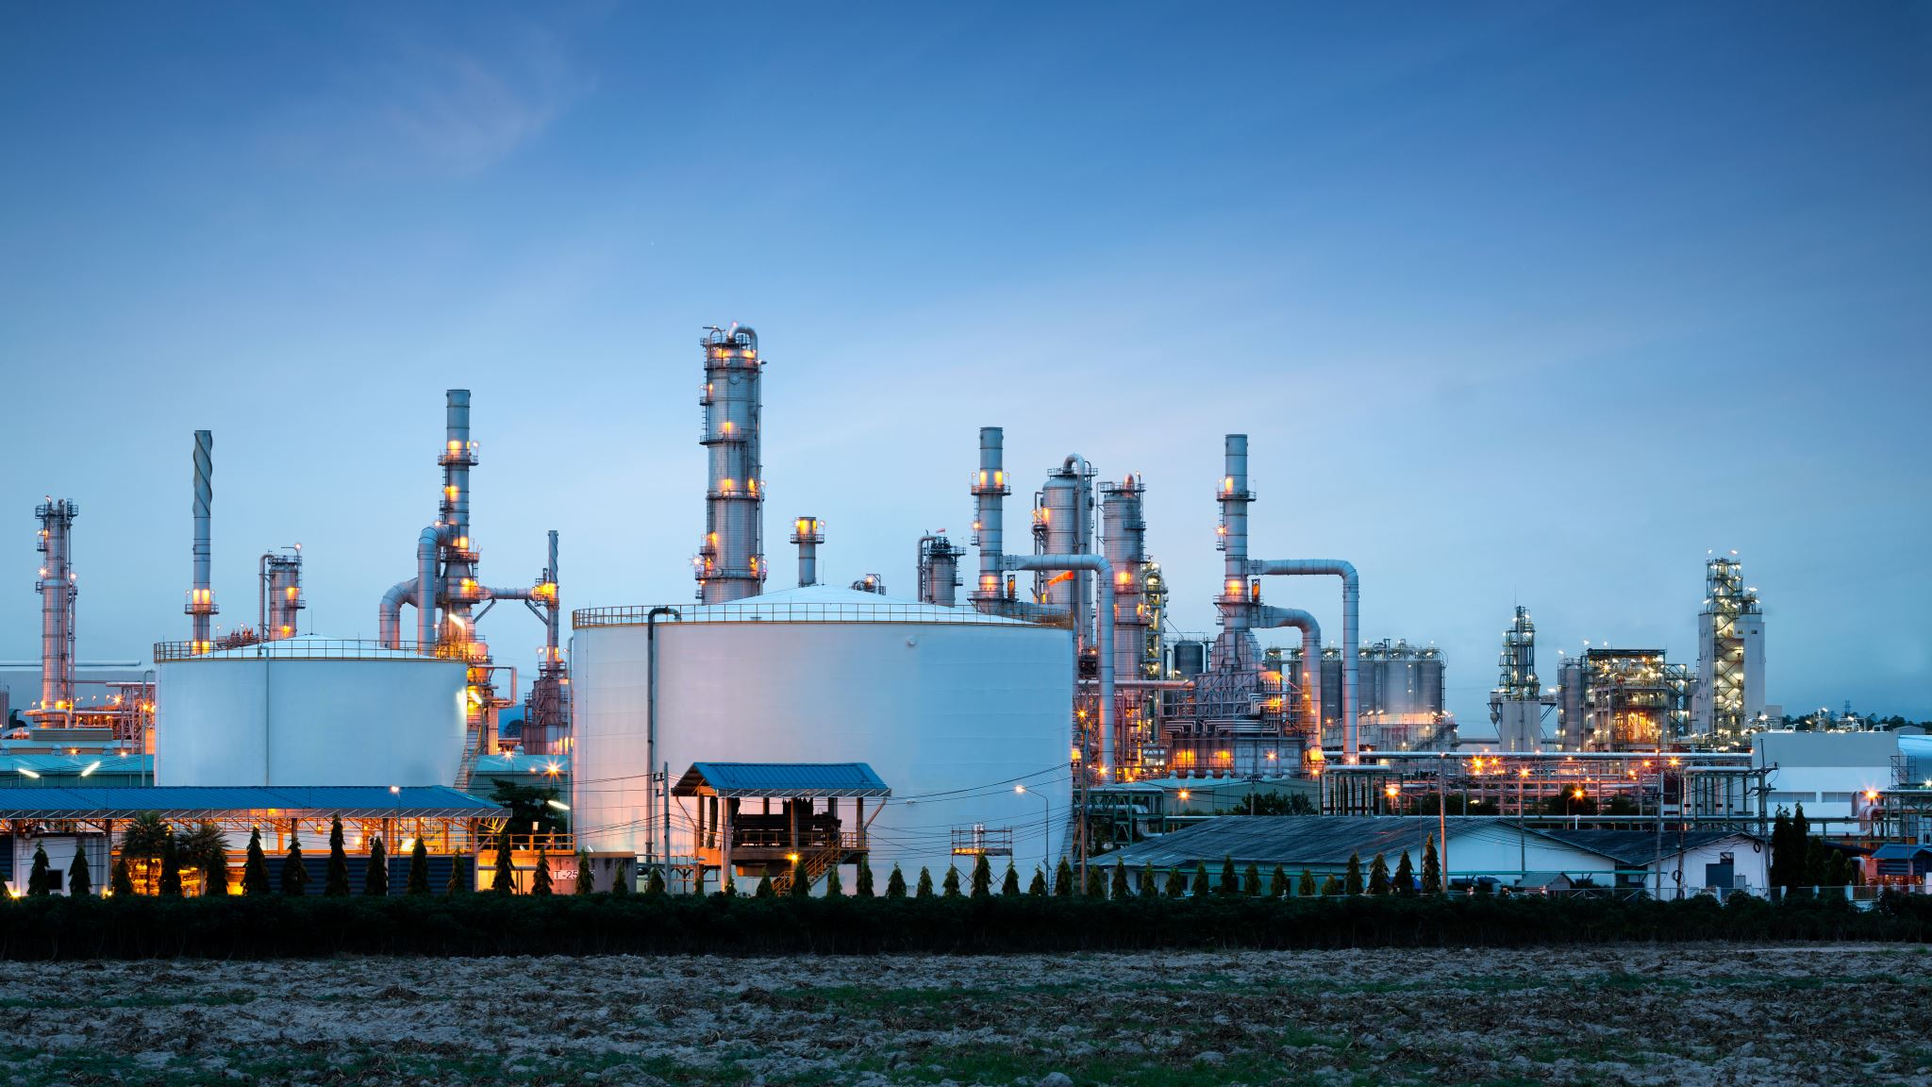
Rand Refinery

Slide 9
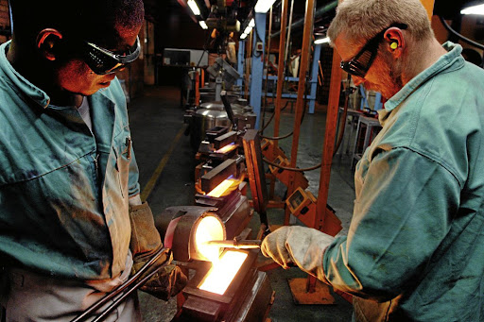
Rand refinery Digital Maturity Consulting
“Digital Transformation Roadmap for Rand Refinery”
The aim for this project was to integrate and optimize systems for the entire enterprise, including all aspects of planning, domestic and international supply and distribution chains, plant operations and support functions.

Slide 10
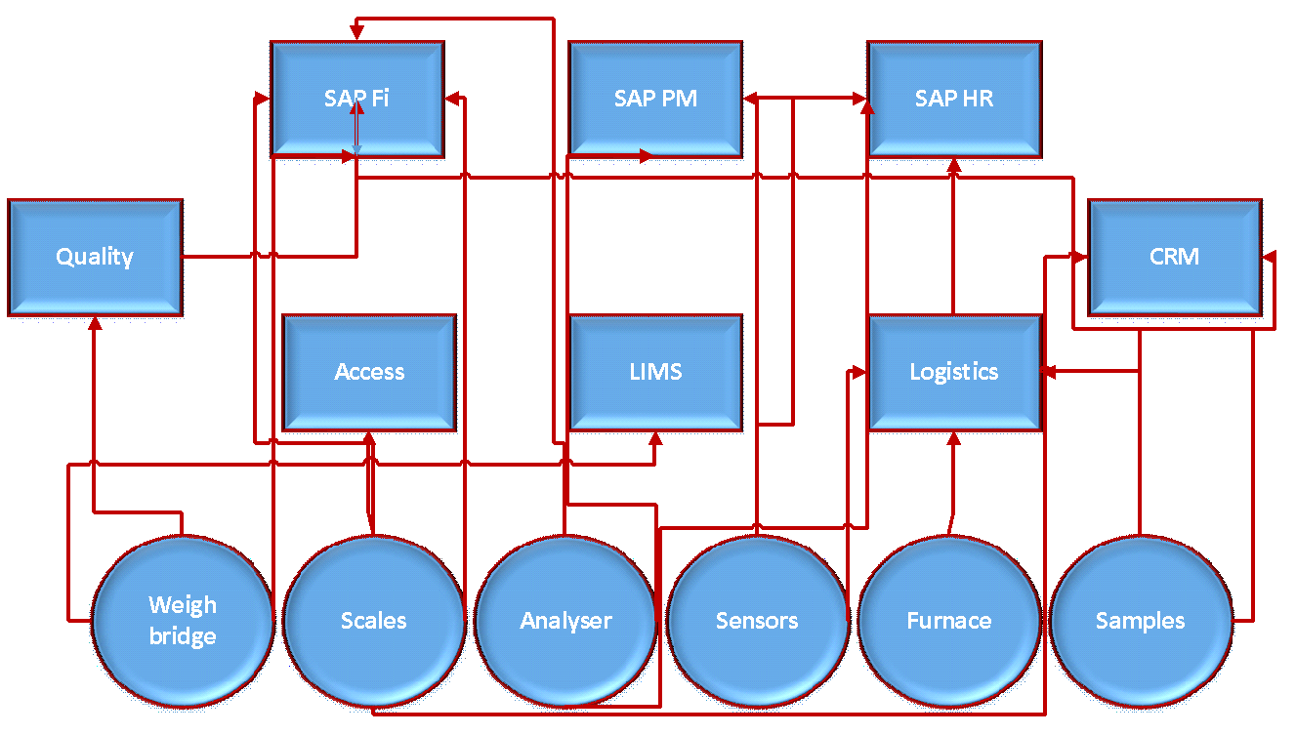
Spaghetti integration of standalone business systems

Slide 11
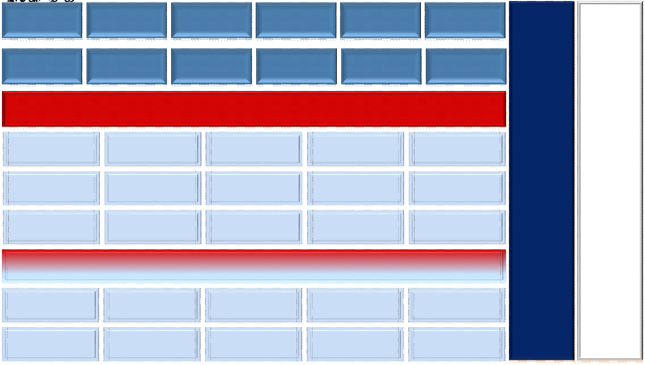
Rand Refinery (Systems integration)
Integration of different business layers for automated workflow.

Slide 12
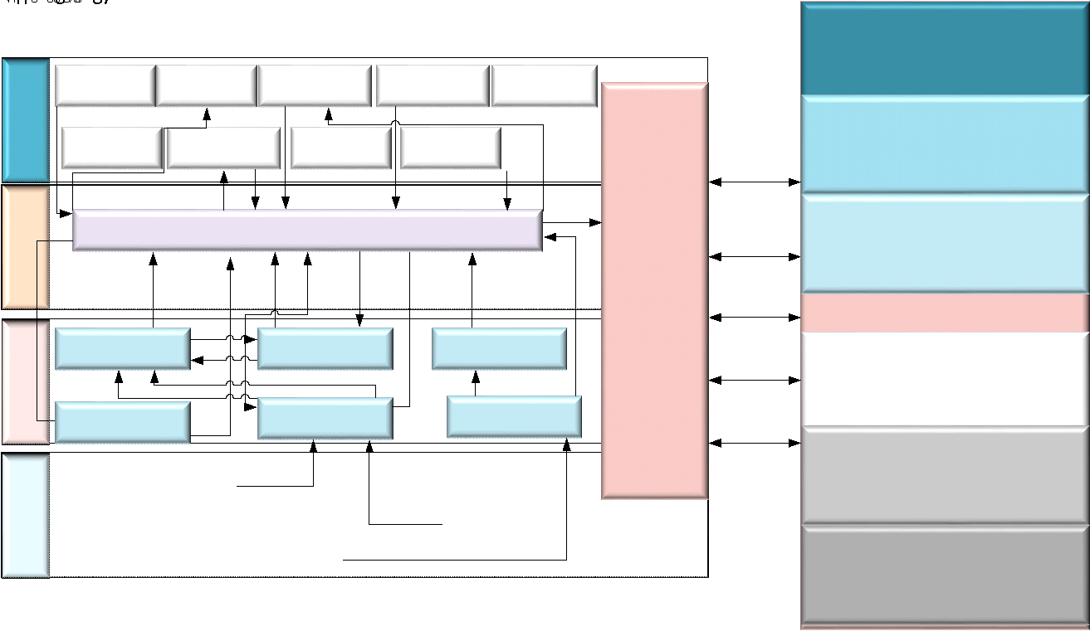
Data reporting and workflow (Rand Refinery)

Slide 13

FoodBev SETA Data Analysis

Slide 14
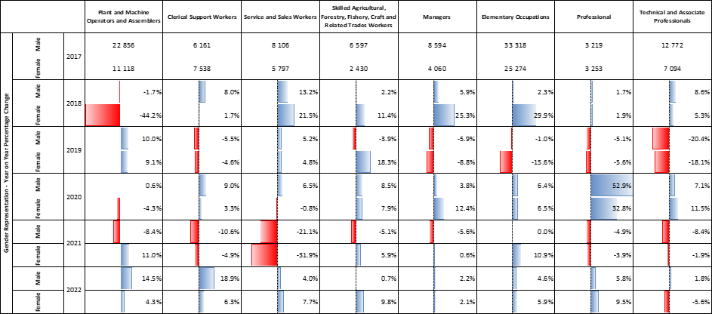
FoodBev SETA Data Analysis
EMPLOYMENT BY GENDER AND OCCUPATIONAL GROUPS.

Slide 15
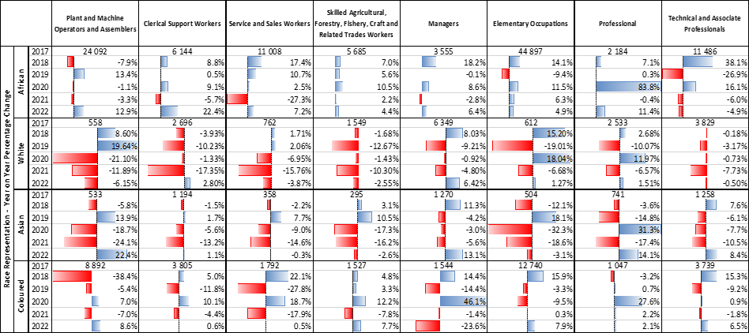

Slide 16
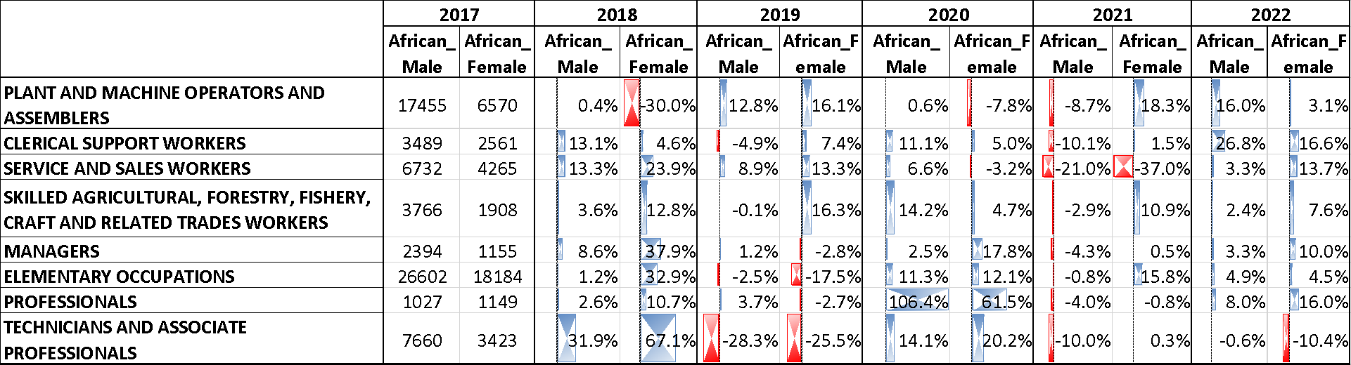

Slide 17
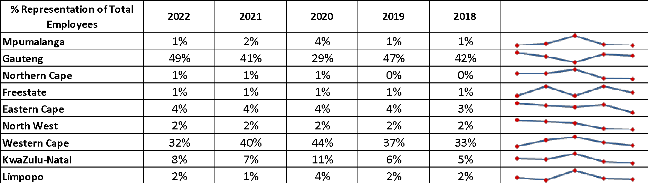

Slide 18
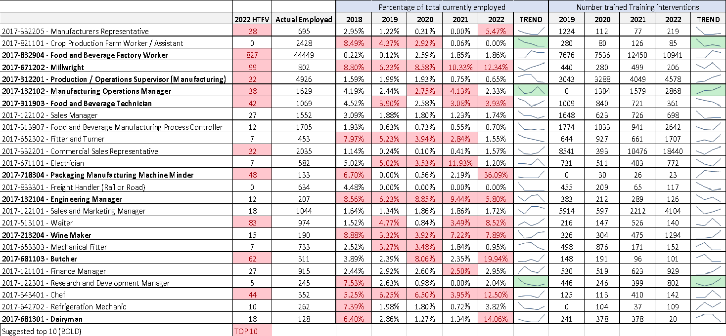

Slide 19

Education and Training

Slide 20


Work Readiness Programme

Slide 21
Accenture and UJ collaboration: Work readiness program for postgraduate students
The project is hosted at the Advanced Technology Center in Devland (Soweto ).
The project provides training to students in various subjects in digital technologies .
The collaboration is inspired by the fact that both UJ and Accenture have aspirational goals and a vision for addressing unemployment, imparting digital skills of the future, and contributing towards the fourth industrial revolution (4IR) in South Africa.
The project is also part of UJ and Accenture’s drive to develop an innovative business model and new ways of working for the skills required for Africa’s digital acceleration.

Slide 22
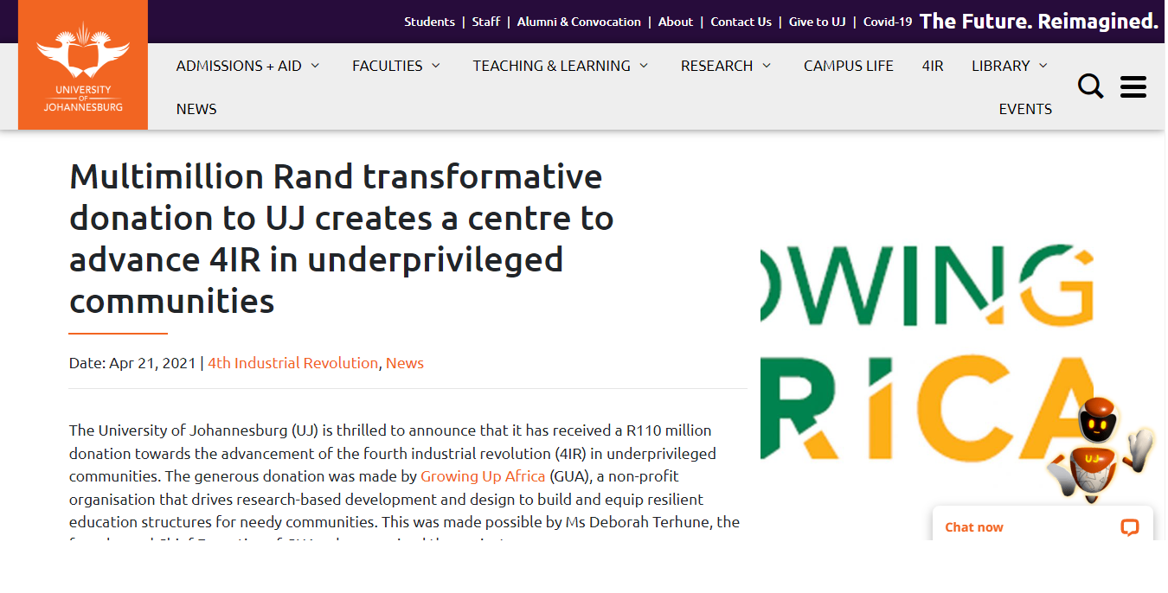
UJ & Accenture – Work Readiness Programme

Slide 23
Accenture and UJ collaboration: Work readiness programme.
4IR Technologies Bootcamp
The programme has produced ### graduates.
###### Some progress about the programme.
######
Engineering Business Systems in 4IR
Subject areas
Agile Rapid Skills Acquisition
Full Stack Web Development

Slide 24
John Hopkins
THABILE DUBE***

Slide 25
Healthcare MBA
THABILE DUBE***

Slide 26
SETA

Slide 27
FoodBev Training

Slide 28

Food and Beverage SETA and UJ collaboration in SME development
The project is a collaboration between UJ, and FoodBev SETA is providing digital skills for SMEs
The project provided training for 225 SMEs on digital transformation processes with respect to key business functionalities.
The project developed 10 systems identified as a need for SME digital transformation.

Slide 29
BankSeta

Slide 30
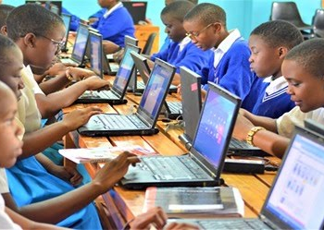
Bank Seta Project – Rural development
“Skills for the future”
This is a project collaboration with University of Johannesburg under auspices of BANKSETA, aiming at unlocking digital technologies to rural school.
The aim of the programme is to train Grade 12 learners from rural schools on 4IR technologies.

Slide 31

CHIETA
SMME focused research to support and grow SME’s
Digital transformation
Support for SSP data collection

Slide 32
MerSeta
THABILE DUBE

Slide 33
Smart Systems & Applications

Slide 34
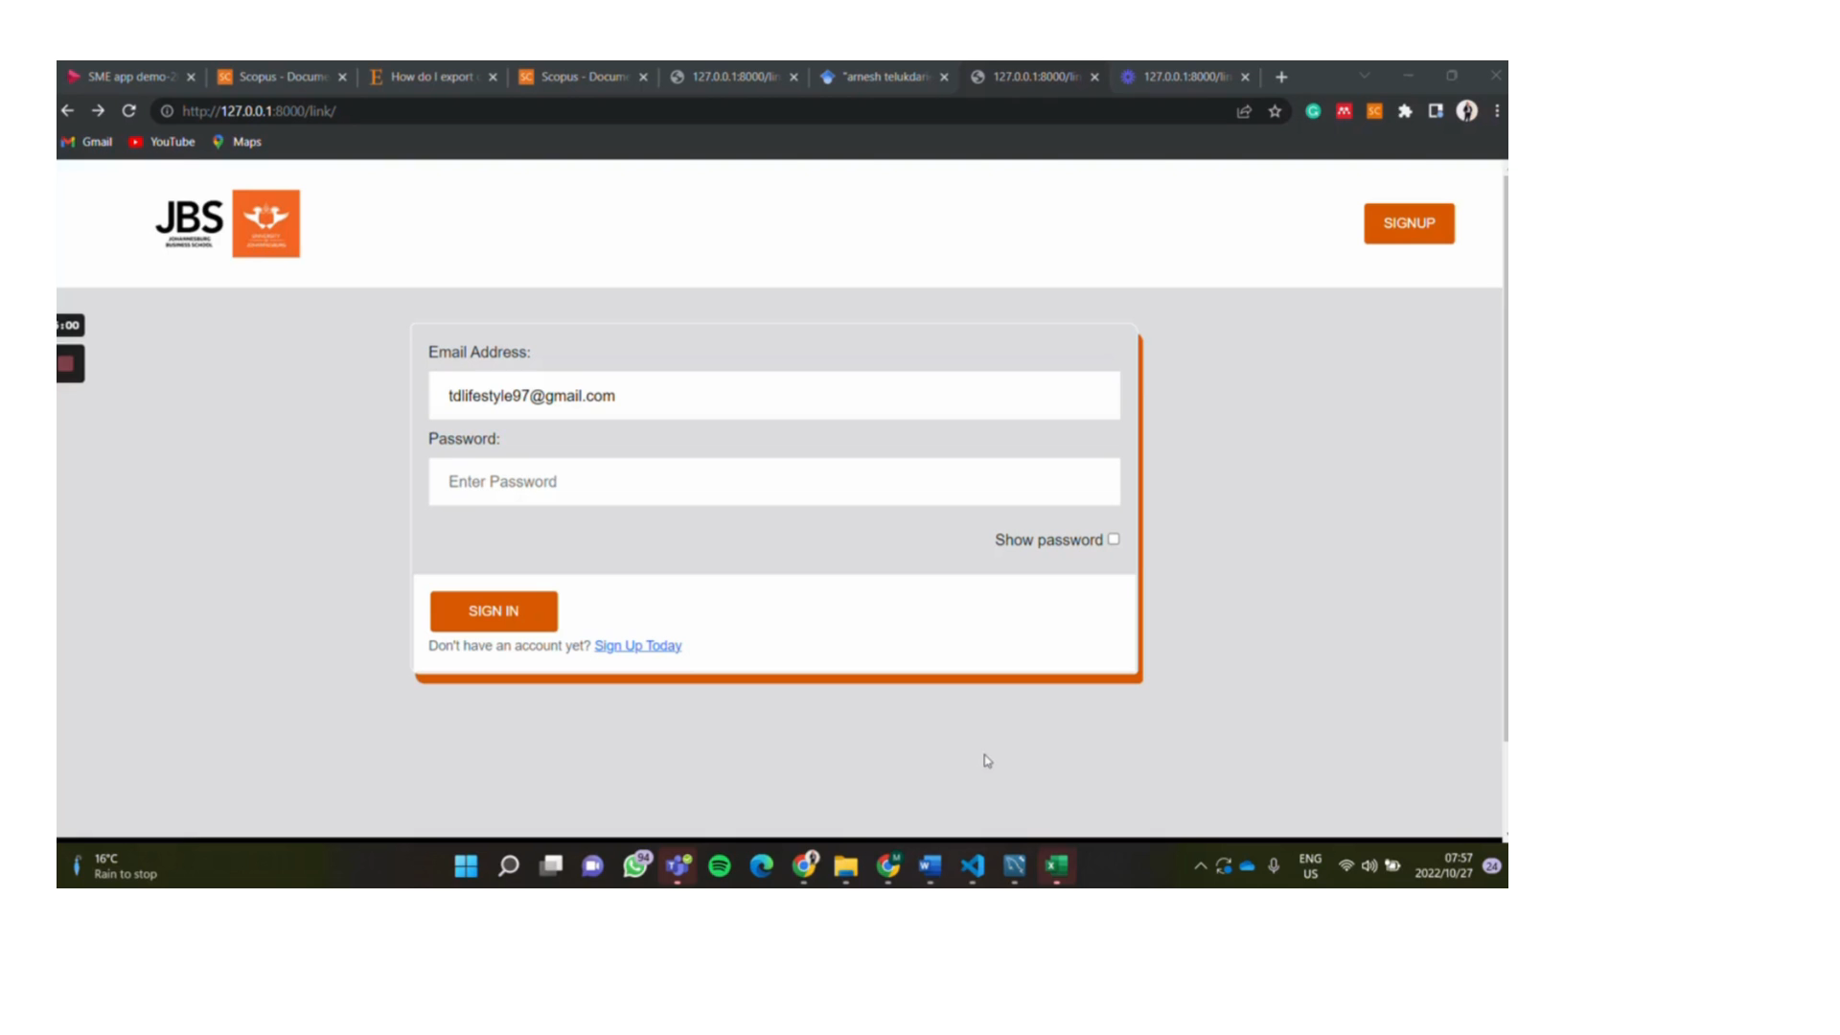
Introduction

Slide 35
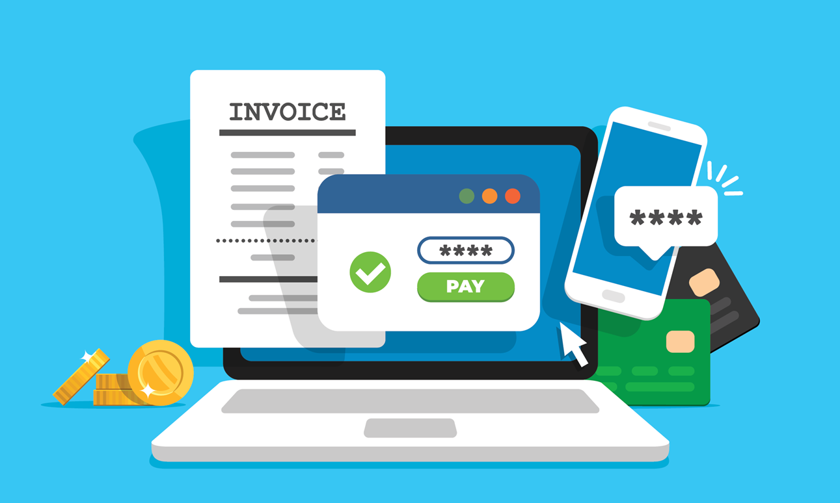
Invoice generator
The TR-Invoice is a free platform that enables SMEs to generate invoices for their firm, making it easier for the firms to receive payments from their consumers.
The app is structured in a manner that it enables the user to integrate information from projects and customer records with the capabilities of summarizing the personal and purchase details of each customer within a single file attached to databases.
The app will be able to perform tax reports, and customer support in the case the system crashes in the process of generating the invoice.

Slide 36
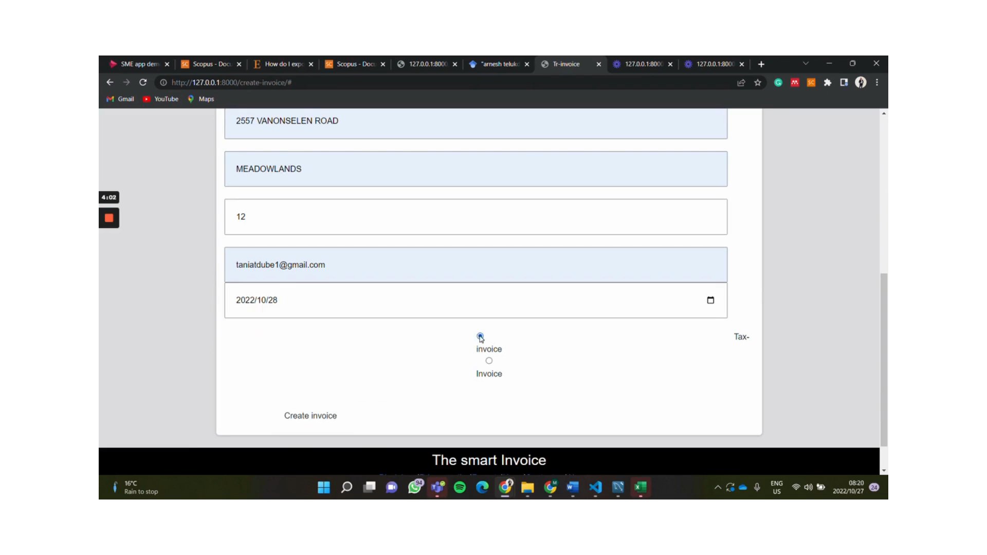
Invoice generator

Slide 37



Business Case
AN APP THAT ENABLES CLIENTS OR USERS TO GENERATE DIGITAL BUSINESS CASE TEMPLATES FOR PROJECTS THEY WISH THEY PURSUE.
THE APP IS STRUCTURED IN A VERY FRIENDLY MANNER AND MAKES IT EASY FOR THE USER TO NAVIGATE THROUGH AND GET ALL THE INFORMATION THEY NEED TO GENERATE A BUSINESS CASE TEMPLATE
TEMPLATES CAN BE DOWNLOADED AS A PDF, OR THEY CAN HAVE IT EMAILED TO THEIR PERSONAL OR COMPANY EMAIL.

Slide 38
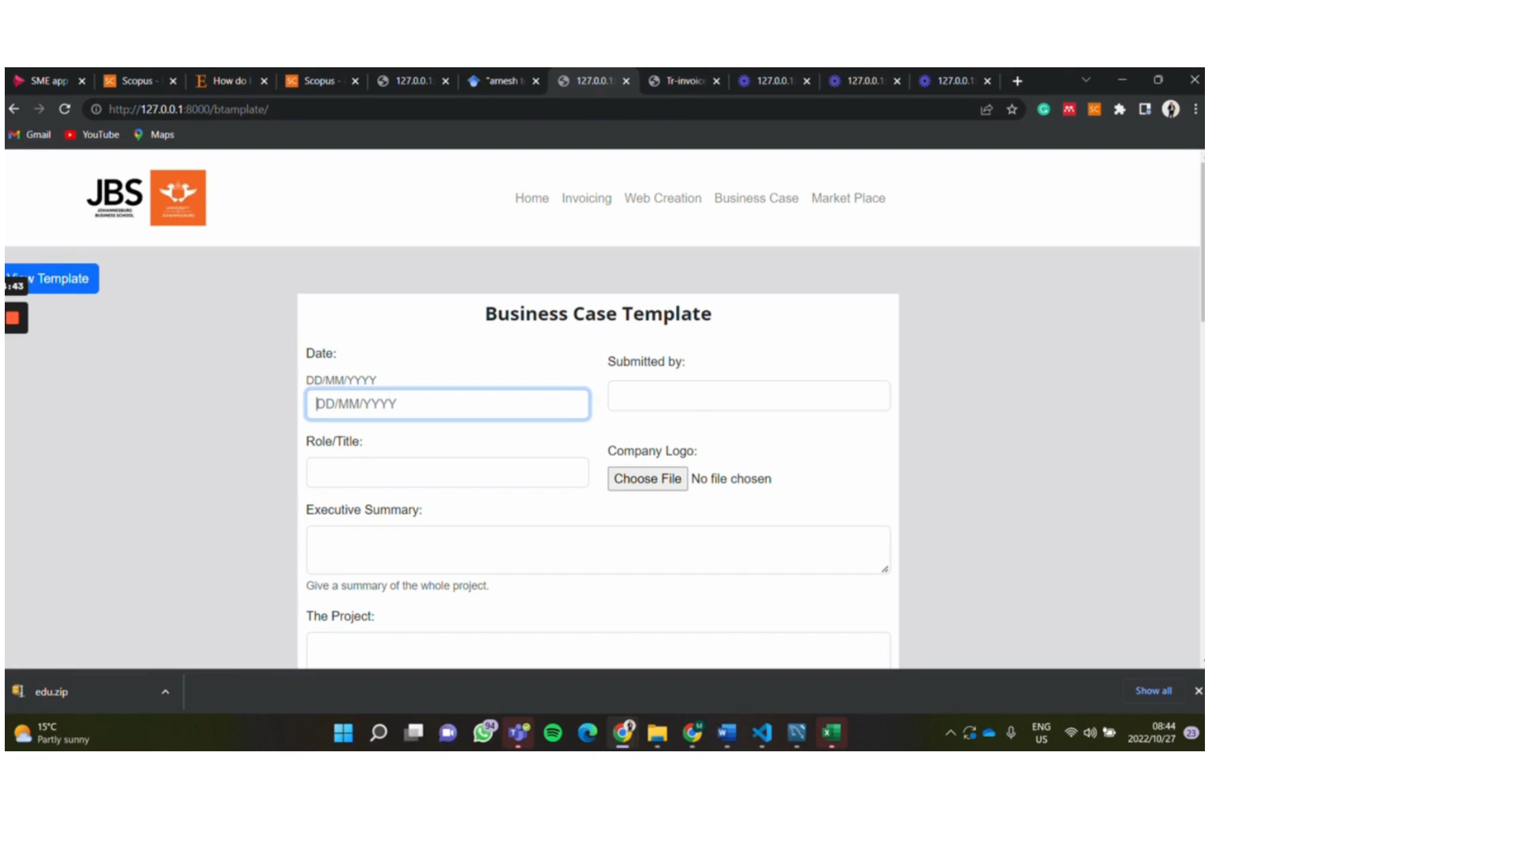
Business case

Slide 39
Child wellbeing tracking tool
Regional*****

Slide 40
The End

